Slide 1
Leveraging SNMP-MIB data for Detection and Classification of Network Attacks
Workflow

Slide 2
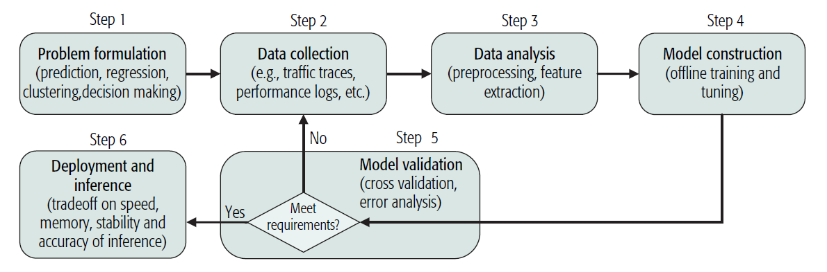
Network Analytics Workflow

Slide 3
Problem Formulation
Detecting and classifying one of the network faults:
TCP-SYN flooding
UDP flooding
ICMP-ECHO flooding
HTTP flood
Slowloris
Slowpost
Brute force attack
ML Paradigm
Supervised Learning: Classification with Random Forest, Multi Layer Perceptron

Slide 4
Data Collection
SNMP-MIB variables in 5 different groups:
Interface group
IP group
ICMP group
TCP group
UDP group
Scenarios for data collection:
MIB variables’ values should be collected during network’s normal behavior and also while each of the attacks is performed.

Slide 5
Data Analysis
Extracting the variables for a particular group and performing data cleaning.
Interface group | Ip group | ICMP group | TCP group | UDP group
ifInOctets | ipInReceives | icmpInMsgs | tcpOutRsts | udpInDatagrams
ifOutOctets | ipInDelivers | icmpInDestUnreachs | tcpInSegs | udpOutDatagrams
ifOutDiscards | ipOutRequests | icmpOutMsgs | tcpOutSegs | udpInErrors
ifInUcastPkts | ipOutDiscards | icmpOutDestUnreachs | tcpPassiveOpens | udpNoPorts
ifInNUcastPkts | ipInDiscards | icmpInEchos | tcpRetransSegs
ifInDiscards | ipForwDatagrams | icmpOutEchoReps | tcpCurrEstab
ifOutUcastPkts | ipOutNoRoutes |  | tcpEstabResets
ifOutNUcastPkts | ipInAddrErrors |  | tcpActiveOpens

Slide 6
Model Construction
Offline training with data on a particular group.
Platform: Python
Environment: Jupyter notebook
Framework: TensorFlow
Library: Scikit-learn
Algorithm: Random Forest, Multi-Layer Perceptron

Slide 7
Model Validation
Evaluation metrics
Precision
Recall
F-Measure
Existing work metric values:
Model | F-Measure
Random Forest | Close to 100%
Multi-Layer Perceptron | 60-83%

Slide 8
Thank You

